Slide 1
Dataset Analysis – Advanced Excel Project
ALBIN K A , 25/02/25 ,
DA & DS DECEMBER BATCH

Slide 2
Project Objective:
To analyze sales data to identify trends, understand sales performance, and provide actionable business insights.
Goals:
Analyze sales trends over time.
Identify high-performing products and sales channels.
Create a dynamic dashboard with key metrics.

Slide 3
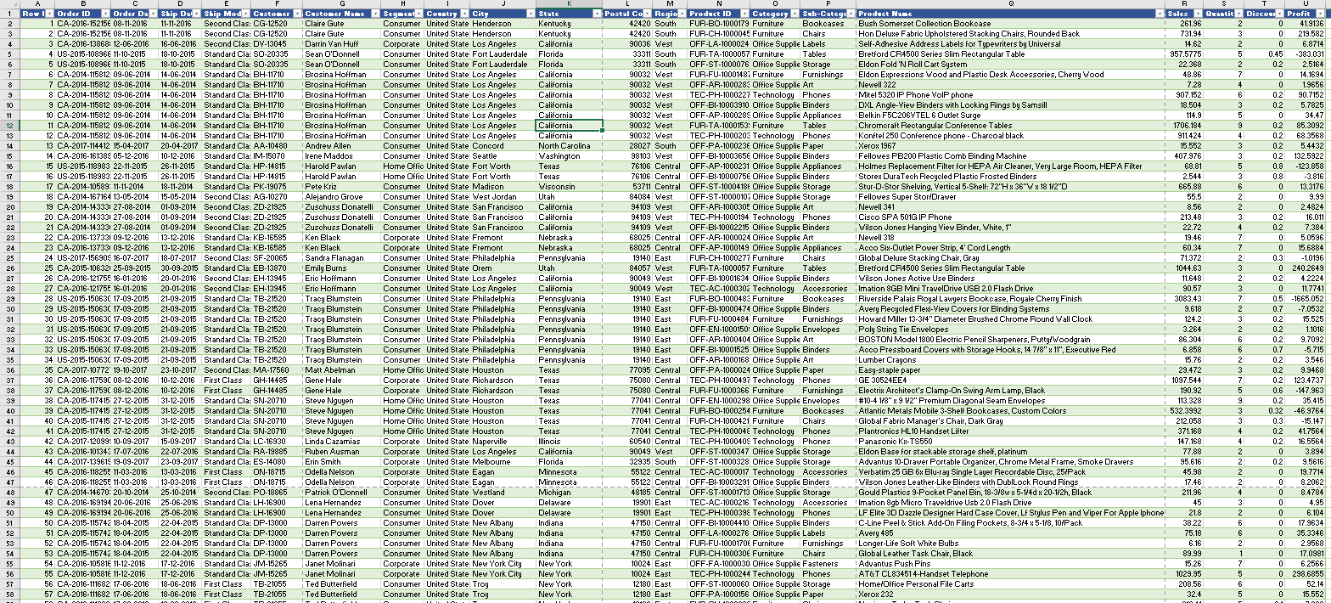
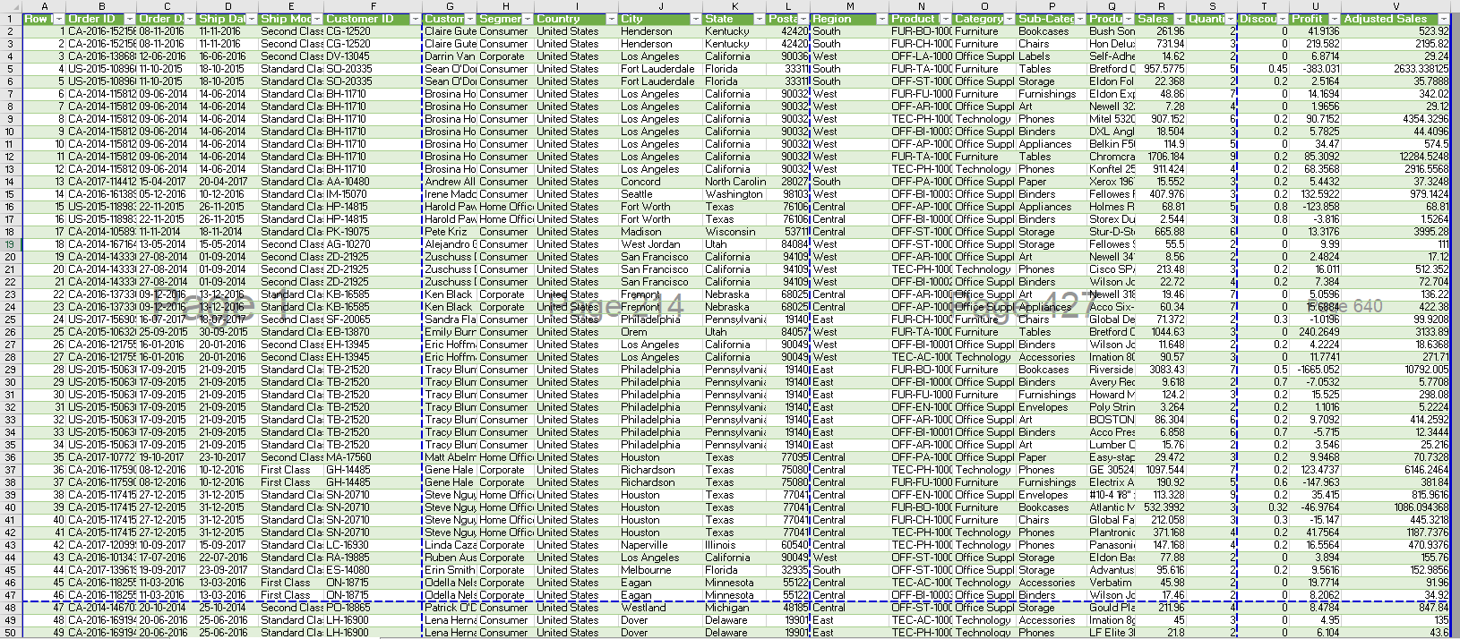
Data Description and Preparation
Dataset Overview:
The dataset consist of ( 149117 rows, columns such as transaction_id ,transaction_date,, transaction_time etc.
Data Cleaning Process:
Check whether any null vale or duplicates in the worksheet.
Visuals

Slide 4
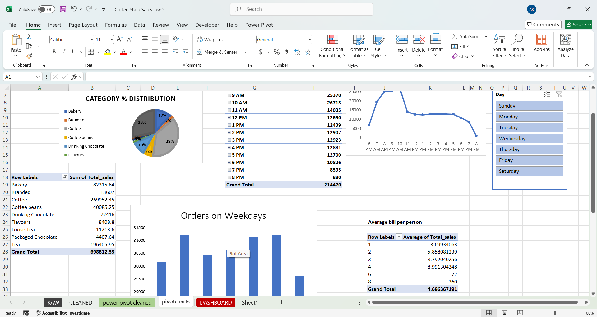
Pivot table
As per required fields selected and create Visualizations.

Slide 5
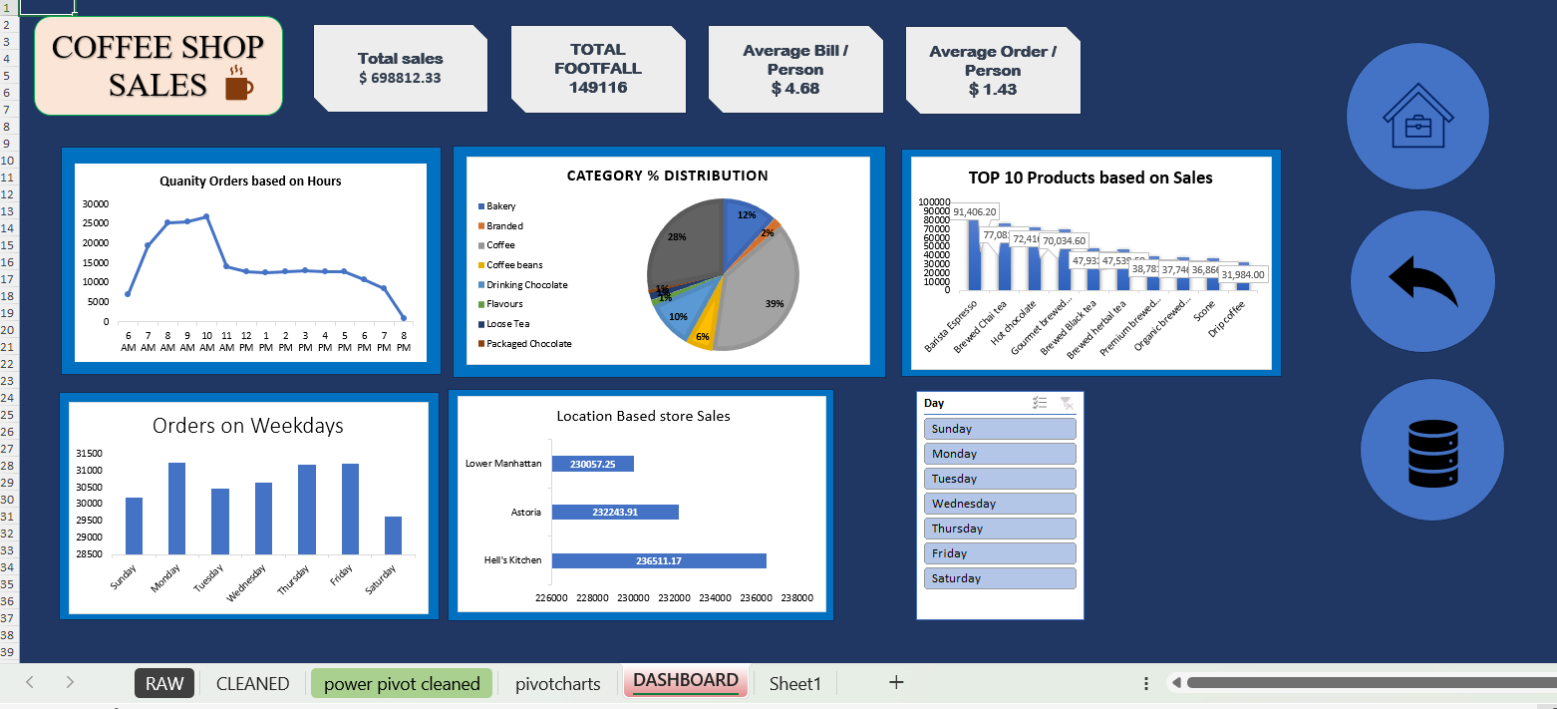
Dashboard Overview

Slide 6
Macros and Automation
BY using macro ---
Freeze the top row
Bold and underlined the Title
Changing the color

Slide 7
Thank You
Any question….?

